Slide 1
Quiz:Game
Teacher: Sir Noor Nabi

Slide 2
Developers
Simran chimrani

Slide 3
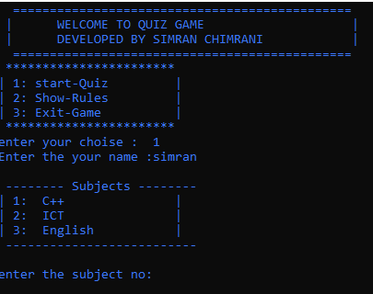
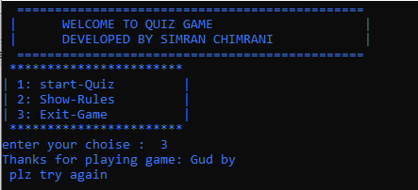
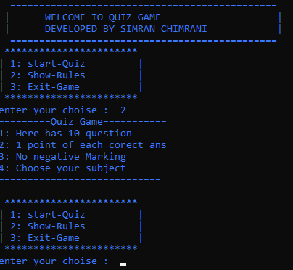
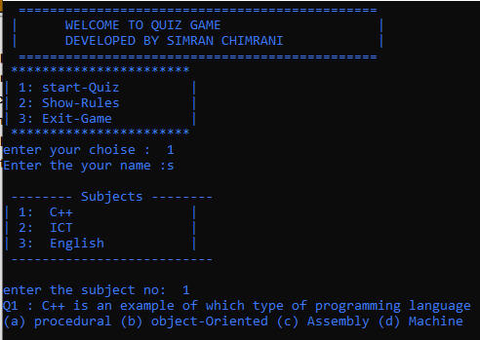

Slide 4
Game Overview
Objective: Subjects based MCQ quiz program that give a score at the end
Key Features:
Subject selection ( cpp,ict,English).
10 MCQs per Subject.
Score based on correct answer.
No negative marking.
Simple Menu and result display.

Slide 5
Game Objects:
Score/result and game nenu
Subject
QUIz:Qno
Score: Tracks points and winner.
Menu: Options to start, view rules, or exit.
player
ICT, CPP, English
10 MCQZ per Subject
Name and Score

Slide 6
classes
Function
Showrules()
Display the quiz rules
Quiz
Manage Quiz flow and score
startquiz()
Lets player choose
Questions
Store question,options,anwer
cpp()
Handle quiz question and scoring
Player
Store name,and Score
Eng()
Handle Eng question and scoring
ICT()
Handle ICT question and scoring

Slide 7
Advantages
Subject Choice: Users can pick subjects, making the quiz flexible.
Interactive Learning: Users learn better by answering questions themselves.
Score Tracking: Shows score automatically so users know how well they did.

Slide 8
THANK YOU
Thank you for your time and attention

